Slide 1

Department of Information Technology
NBA Accredited A.P. Shah Institute of Technology G.B.Road,Kasarvadavli, Thane(W), Mumbai-400615 UNIVERSITY OF MUMBAI Academic Year 2020-2021

Slide 2
A Project Presentation on ML Based Web Framework for Fake News Detection Submitted in partial fulfillment of the degree of Bachelor of Engineering(Sem-8) in INFORMATION TECHNOLOGY By Jaagrut Shah(19204002) Jigar Desai (19204003) Yash Jain (19204013) Under the Guidance of Prof. Apeksha Mohite
Prof. Geetanjali Kalme

Slide 3
1.Project Conception and Initiation

Slide 4
1.1 Abstract
Fake news has been a drag ever since the web boomed. The news or social media network’s that allows us to gather information about incident’s happening over this world can be contaminated with fake news to run a particular political or personal agenda. Combating this fake news is vital because the world's view is formed by information. Verifying each news one by one by a person's being is totally unfeasible.
This project attempts to expedite the method of identification of fake news by proposing a system which will try to reliably classify and predict if a news can be fake or not. The arduous task of detection of fake news are often made trivial with the usage of the proper models with the proper tools. To automate the analysis of such data, the world of Sentiment Analysis has emerged.

Slide 5
1.1 Abstract
Sentiment Analysis may be a problem of text-based analysis, but there are some challenges that make it difficult as compared to traditional text-based analysis, This clearly states that there is a need for an attempt to work towards these problems and it has opened up several opportunities for future research for handling negations, hidden sentiments identification, slangs, polysemy.
However, the growing scale of knowledge demands automatic data analysis techniques like analyzing text using Natural Language Processing. In this paper, an in-depth survey on different techniques utilized in Fake News Prediction & Sentiment Analysis is administered to know the extent of labor.

Slide 6
1.2 Objectives
To show the news relevancy and analysis to attain accuracy in anticipating real and dependable news.
To work on this issue, a layered model is proposed, which fine-tunes the information insight received from the data at each phase before attempting a prediction.
To use a variety of Machine Learning approaches, achieve demonstratable success in the prediction of fake news and posts.
To eliminate the propagation of false information on social media that may mislead users.
To be able to give more and more accurate news on the screen.

Slide 7
1.3 Literature Review
Sr. No. | Authors | Paper Titles | Findings
1 2 | Alim Al Ayub Ahmed, Ayman Aljabouh, Praveen Kumar Donepudi, Myung Suh Choi Shu et al Sadia Afroz, Michael Brennan, and Rachel Greenstadt | Detection of online fake news using N-gram analysis and machine learning Technique. Fake news detection on social media | ML models including Knearest neighbor (KNN), support vector machine (SVM), logistic regression (LR), linear support vector machine (LSVM), decision tree (DT), and stochastic gradient descent (SGD), achieving the highest accuracy (92%) with SVM and logistic regression. Achieved better accuracies with different models by combining textual features with auxiliary information such as user social engagements on social Media.

Slide 8
1.4 Problem Definition
Problem Identified:
The Easy Access and exponential growth of the information available on social media networks has made it intricate to distinguish between false and true information.
The easy dissemination of information by way of sharing has added to exponential growth of its falsification.
Solution Proposed:
With The help of ML algorithms, and the data sets we would try to eliminatethe fake news which is being spread and trying to alter the emotions of people reading news.

Slide 9
1.5 Scope
The fake news challenge is perilous and is spreading rapidly like a wildfire as it becomes easier for information to reach the mass in various flavours.
Fake news can have a huge impact in politics and thereafter on the people like a domino effect. With the help of Machine Learning & Artificial Intelligence, we can control and limit the spread of such misinformation more quickly and efficiently as compared to manual efforts.
There are various Up’s and Down’s on the market or in people’s lives after they read the news that was Falsely claimed to be True. This project will assure them, that the news is True or False, this approach will Solve many problems like riots.

Slide 10
1.6 Technology stack
Software Requirements:
Python libraries
Bootstrap
Framework: Flask
Machine-Learning Classification models
OS Requirements: Windows XP or above
JavaScript supported browsers
Hardware Requirements:
Minimum 2GB Ram
Pentium / Intel i3 Processors or above

Slide 11
1.7 Benefits for Society
In today's world, there is a great deal of information available, yet 80 percent of it is noise and only 20% of it is valuable. Our idea will serve as a forum for them to classify the news they receive as "genuine" or "fake," as well as the emotions portrayed in the news.

Slide 12
2. Project Design

Slide 13
2.1 Proposed System
The model to be made for predicting the relevance of a News can be approached through the proposed steps to be followed. They are listed below as:
Collecting Data from datasets
Data cleaning and Pre-processing
Feature Extraction using TFIDF
Providing data to Models
Result Analysis
The Model is chosen based on the best accuracy providing one and the user passed data is passed through the model to predict the result. Also, the Sentiments are similarly classified into Positive, Negative and Neutral. The analysis of sentiments depends upon the:
Methods Of NLP
Similarly, the prediction of Fake or Not depends upon the features extracted (i.e., no. of words along with their inverse frequency converted to numeric using vectorization) using TFIDF from the combined text total obtained by either user of twitter API. The classification here depends on:
Features present in Text.
Probability calculation

Slide 14
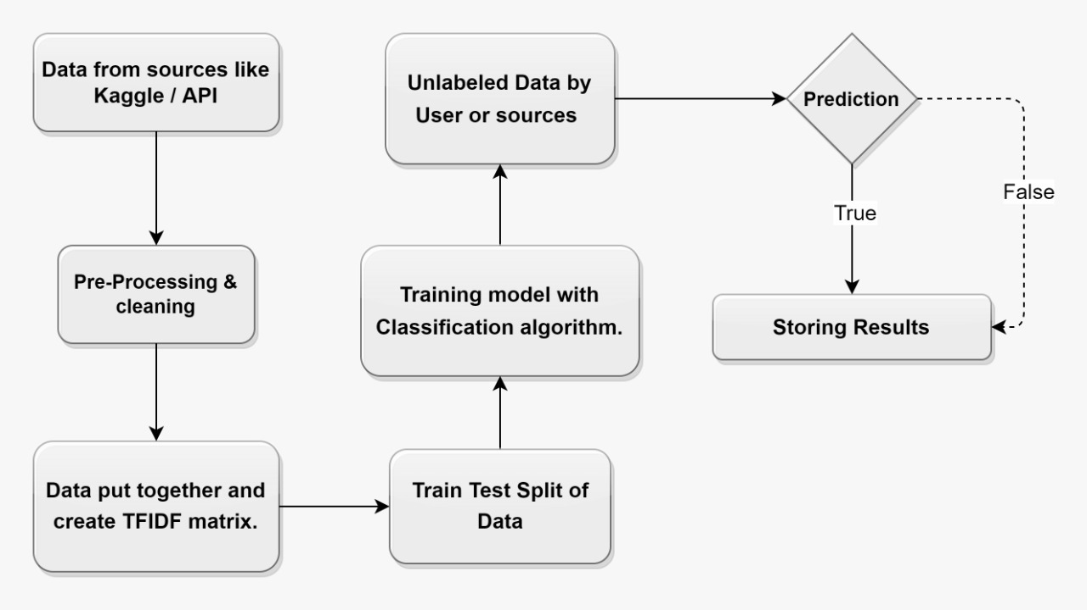
2.2 Design(Block Diagram)

Slide 15
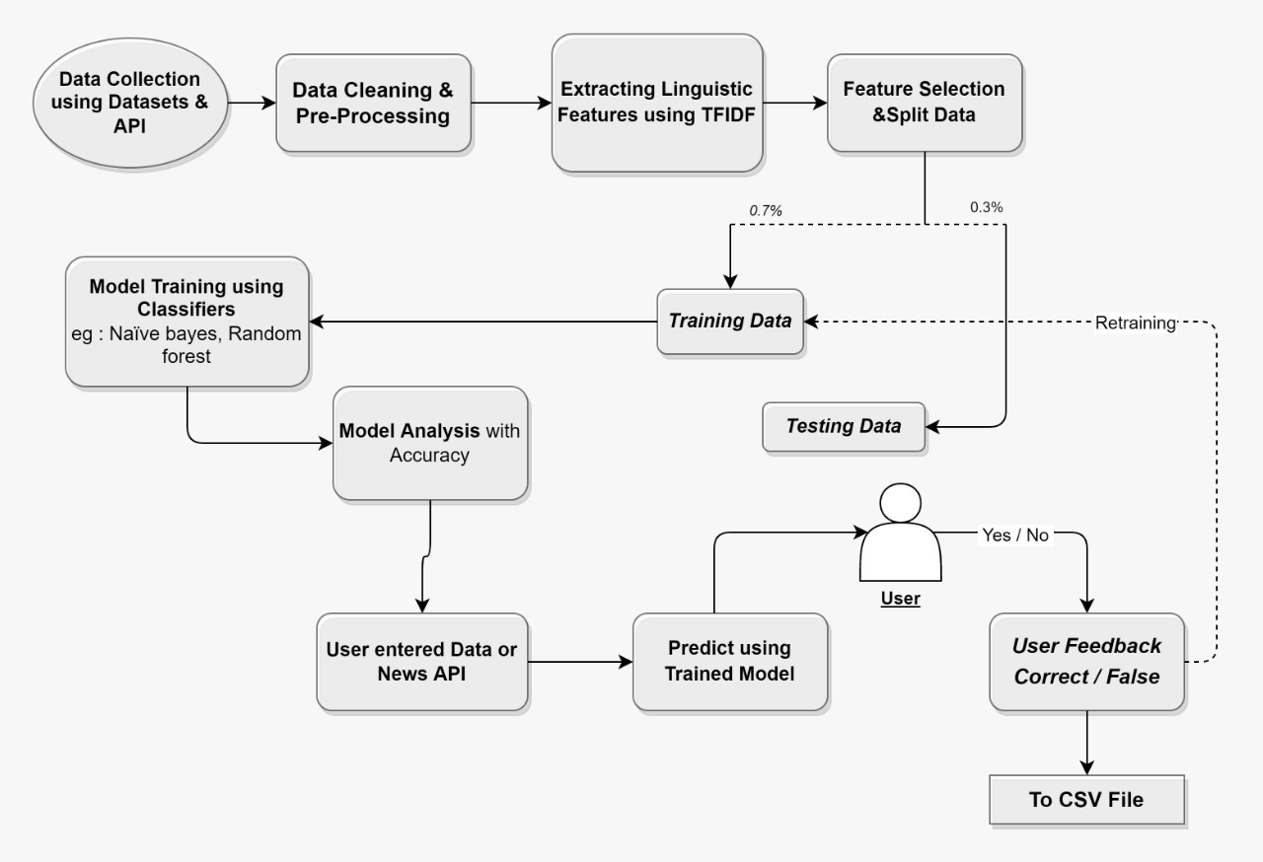
2.3 Design(Flow Diagram)

Slide 16
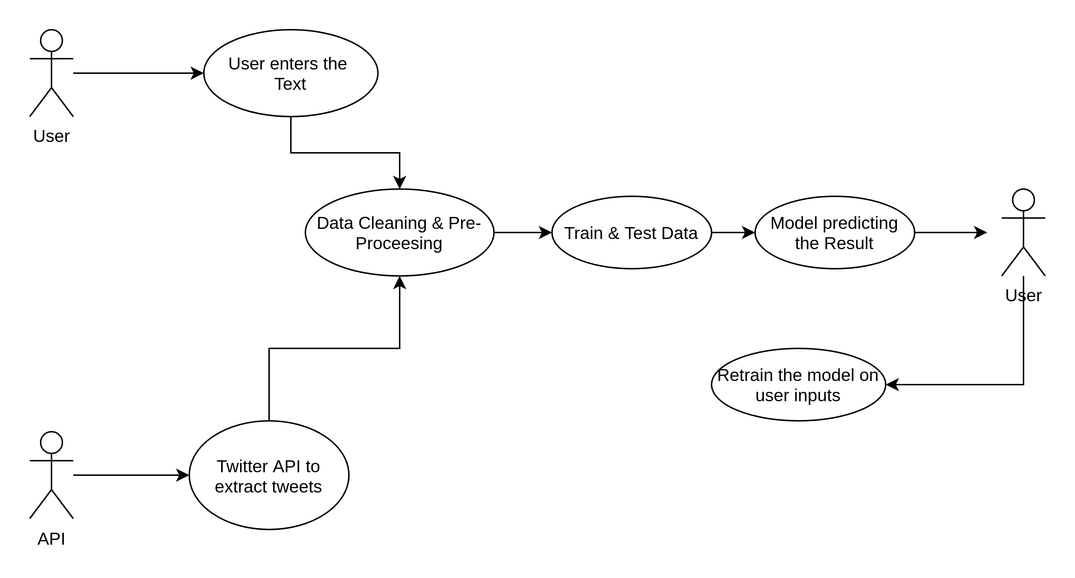
2.4 Design(Use Case Diagram)

Slide 17
3. Implementation

Slide 18
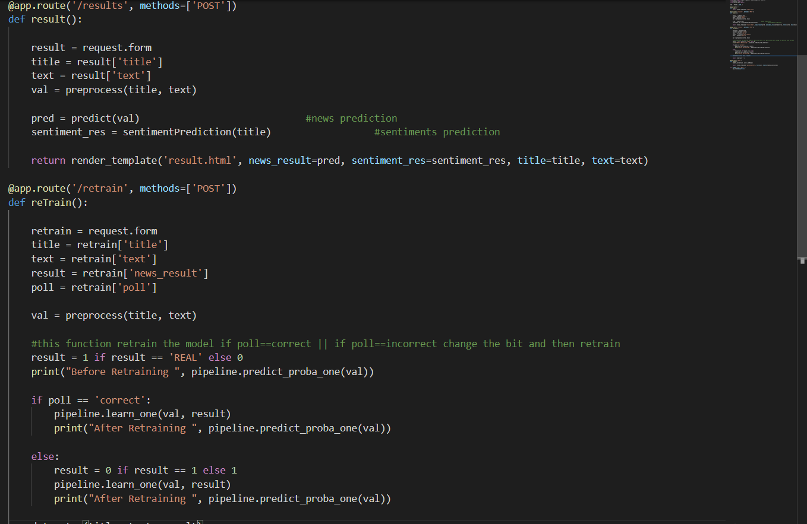
3.1 Application Implementation

Slide 19
4. Result

Slide 20
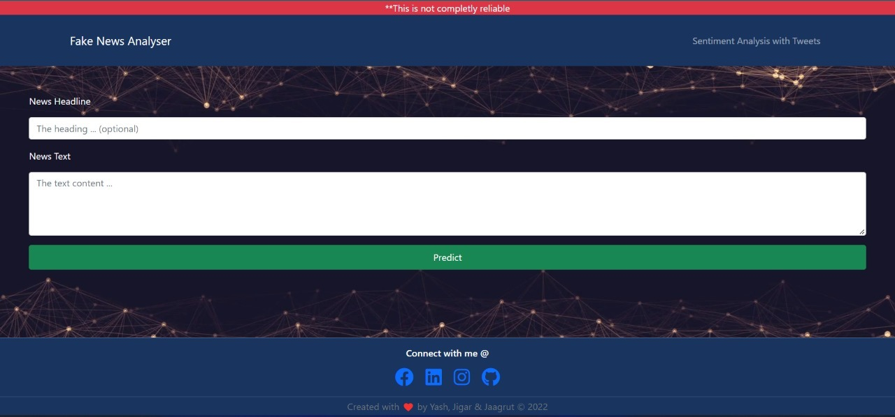
4.1 Result

Slide 21
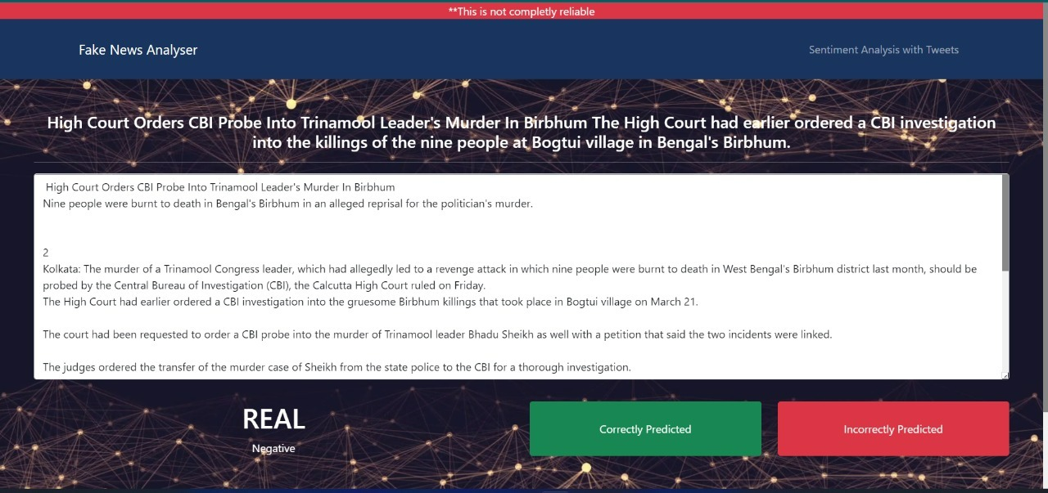
4.2 Result

Slide 22
4.3 Result
We give user an option to enter the text of news received, as title and the content. After they submit it through predict button the text is preprocessed and next they are passed through a pipeline where is passed to TFIDF for generating numeric metric of the text, as soon as it converted it is passed through the model which was trained earlier on the dataset. The model then provides he result as 1 or 0 where, 1 being Real and 0 as Not real. Which is then displayed to the user along with the news entered, and simultaneously in this process the sentiments are being analyzed and displayed on the same page. We have provided a feedback button on the page where the results are displayed so that the user get`s an option to provide his input over the news result. Use this input to retrain the model and save it to a CSV file.

Slide 23
5. Conclusion and Future Scope

Slide 24
Fake news is categorized as any kind of cooked-up story with an intention to deceive or to mislead. In this paper we are trying to present the solution for fake news detection task by using Machine Learning techniques. With this, endeavors are being made to automate the task of fake news detection. The most mainstream of such actions include blacklisting of sources and authors that are unreliable. Even though these tools are useful, but in order to produce a progressive complete end to end solution, we are required to represent for tougher cases where reliable sources and authors are responsible for releasing fake news. The outcomes of this project shows the capability of ML to be fruitful in this task. We have tried to build a model that helps in catching many intuitive indications of real and fake news as well as in the visualization of the classification decision.

Slide 25
References
S. A. García, G. G. García, M. S. Prieto, A. J. M. Guerrero, and C. R. Jiménez, “The impact of termfake news on the scientific community scientific performance and mapping in web of science,” Social Sciences, vol. 9, no. 5, 2020.
Ammara Habib, Muhammad Zubair Asghar, Adil Khan, Anam Habib, Aurangzeb Khan, “Falseinformation detection in online content and its role in decision making: a systematic literature review”,Springer-Verlag GmbH Austria, part of Springer Nature 2019.
D. M. J. Lazer, M. A. Baum, Y. Benkler et al., “The science of fake news,” Science, vol. 359, no. 6380, pp. 1094–1096, 2018.
Mykhailo Granik, Volodymyr Mesyura, “Fake News Detection using Naïve Bayes Classifier”, 2017 IEEE First Ukraine Conference on Electrical and Computer Engineering.
Shlok Gilda,” Evaluating Machine Learning Algorithms for Fake News Detection”, 2017 IEEE15th Student Conference on Research and Development.

Slide 26
Paper Publication
2nd International Conference on Advance Computing and Innovative Technologies in Engineering Conference
Date: 28th to 29th April, 2022
Submission Status : Need to reduce the plagiarism percentage.
ICT4SD CONFERENCE Seventh International Conference on ICT for Sustainable Development
Date: 26th April, 2022
Submission Status : We must submit a new submission once we have reviewed the plagiarism percentage.
International Conference on Educating the Millennials (ICEM)’22
Date: 22th April, 2022
Submission Status : The abstract has been approved, but the paper must be resubmitted for final review.

Slide 27
Thank You

